Slide 1
“Every journey has a secret destination of which the traveler is not aware.” ~ Martin Buber

Slide 2
Icebreaker
How do you define health?
How do you define health within the Extension context? (program or otherwise)

Slide 3
Overview
What is health?
Survey Results - Southern Region Snapshot
Wednesday’s progress
Big ideas
Discussion
Unanswered questions
Next Steps

Slide 4
What is health?
“a complete state of physical, mental and social well-being and not merely the absence of disease or infirmity”
World Health Organization

Slide 5
Health Promotion as a Process
Process of enabling people to increase control over and improve their health
Health is a resource for everyday life, not simply the objective of living.
Fundamental conditions and resources needed for good health, including peace, shelter, education, food, income, and a stable ecosystem.
Ottawa Charter for Health Promotion

Slide 6
“It is rare to recognize the beginning of great change while you are living it because it does not present itself as spectacular. It trickles in. Carried and cultivated by everyday people. ”
http://www.rwjf.org/en/library/annual-reports/presidents-message-2014.html

Slide 7
Survey Results

Slide 8
Health Specialist Characteristics
Characteristics | Health Specialist (n=17) Mean ± SD or N (%)
Age | 43.21 years ± 11.49 (Range: 30 – 64 years)
Years Extension Experience | 8.73 ± 8.73 (Range: 1 – 33 years)
Years in Health Specialist role | 6.27 ± 6.38 (Range: 1 – 22 years)
Master’s Degree | 33.3%
Doctoral Degree | 67.7%
Thesis/Dissertation Completion | 93.3%

Slide 9
Faculty Appointment
Mean: 87.88 ± 19.66
Range: 25 – 100%
Mean: 11.00 ± 18.67
Range: 0 – 75%
Mean: 1.12 ± 4.47
Range: 0 – 19%

Slide 10
Notes:
bachelors

Slide 11
Notes:
masters

Slide 12
Notes:
Doctoral degrees

Slide 13
Why are we here?
Potential partners for programming (46.2%)
Potential Partners for Research (15.4%)
Just to get to know everyone; I’m not yet sure I want a partner (15.4%)
I’m not sure. My supervisor told me to go (7.7%)
Other (15.4%): Both programming and research partners
21.4% are nervous about collaboration
Notes:
Reasons for collaboration nervousness
Establishing clear roles and responsibilities/ objectives; clear and effective communication styles with new collaborators; different working styles
General concern over academic/intellectual credit; but more so excited to collaborate
I already have a lot of demands on my time. Adding responsibilities through collaboration with other individuals could be very overwhelming

Slide 14
Grants & National Team Participation
Characteristics | Health Specialist (n=17)
Grant Experience, n (%) Applied and received more than one Have applied and received one Have applied and received none | 9 (64.3%) 2 (14.3%) 3 (21.4%)
National Team Participation, n National Framework for Health & Wellness Health Action Teams Nutrition and Health Planning & Guidance Committee 2017 National Health Outreach Conference Planning Committee eXtension Community of Practice-Families, Food & Fitness eXtension Community of Practice- Creating Healthy Communities | 4 2 2 1 5
Notes:
Grant Experience and Collaboration (only 14 responses)
Reasons for collaboration nervousness
Establishing clear roles and responsibilities/ objectives; clear and effective communication styles with new collaborators; different working styles
General concern over academic/intellectual credit; but more so excited to collaborate
I already have a lot of demands on my time. Adding responsibilities through collaboration with other individuals could be very overwhelming
Other Grant Mechanisms
NSF
State Government Agencies
Health Departments
Tobacco Commission

Slide 15
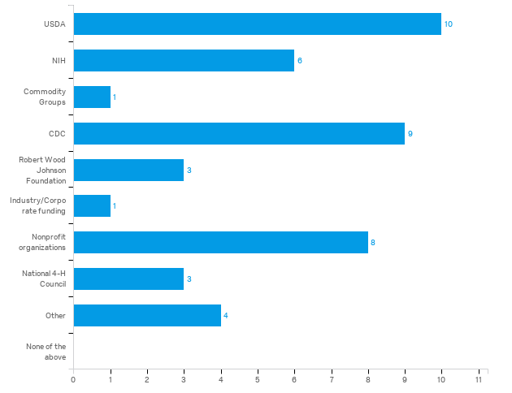
Funding Sources

Slide 16
Activity | Completely Confident | Very Confident | Moderately Confident | Somewhat Confident | Not At All Confident
Collecting Data | 7.1 | 64.3 | 28.6 | -- | --
Analyzing Data | 14.3 | 21.4 | 57.1 | 7.1 | --
Writing Journal Articles | 28.6 | 21.4 | 42.9 | 7.1 | --
Reading Journal Articles | 71.4 | 21.4 | 7.1 | -- | --
Writing Grant Proposals | 28.6 | 50 | 7.1 | 7.1 | 7.1
Preparing Conference Materials | 28.6 | 42.9 | 14.3 | 7.1 | 7.1
Conducting Research | 35.7 | 21.4 | 28.5 | 7.1 | 7.1
Developing Curriculum | 7.1 | 21.4 | 50 | 14.3 | 7.1

Slide 17
Activity | Completely Confident (%) | Very Confident (%) | Moderately Confident (%) | Somewhat Confident (%) | Not At All Confident (%)
Contributing to Curriculum Development | 21.4 | 35.7 | 35.7 | 7.1 | --
Reviewing Conference Abstracts and Proposals, curriculum | 21.4 | 50 | 28 | -- | --
Administering Grant Programs | 23.1 | 46.2 | 23.1 | 7.7 | --
Conducting Program Evaluation | 4.3 | 50 | 35.7 | -- | --
Providing guidance for local program implementation | 28.6 | 57.1 | 14.3 | -- | --

Slide 18
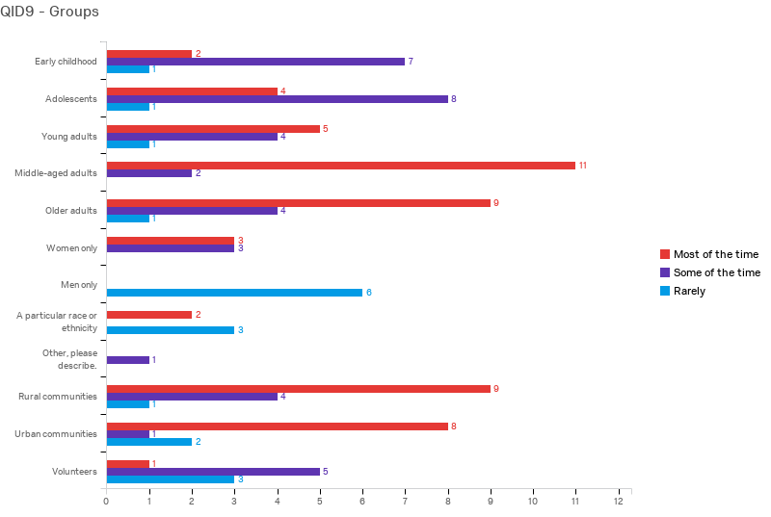
Target Audiences for Current Programs

Slide 21
Wednesday’s Work
4 hour (3.5ish with breaks)
16 faculty, 10 states
National Program Leader – Family & Community Health
Impromptu Networking, Lightning Talks, Exploring Purpose, Generating and Sifting Ideas

Slide 22
8 Big Ideas
Curriculum
Choose a single common curriculum for southern states to adopt, implement and evaluate for a set period (perhaps 3 – 5 years), report outcomes and impact in shared venture
First step: Identify the program

Slide 23
8 Big Ideas
Curriculum
Reduce curriculum redundancy in high-need content areas.
First step: Identify and recommend 5 – 6 curricula for use across Extension in high-need content areas

Slide 24
8 Big Ideas
Evaluation
Develop a system to identify best programs needing strengthened evidence base; create regional teams to work on them – data collection, funding proposals, publication
First step: Survey specialists to provide program info

Slide 25
8 Big Ideas
Evaluation
Gain understanding of impact of current Extension programs
First step: Develop data collection system

Slide 26
8 Big Ideas
Evaluation
Evaluate all health programming and understand audiences they reach
First step: Gather info by state on programming and categorize

Slide 27
8 Big Ideas
Training
Entire Extension staff receive ongoing training on cultural competence, equity, social determinants of health, and social justice.
First step: Identify training available.

Slide 28
8 Big Ideas
Marketing
Better marketing/communication of what we are already doing to build a culture of health (whether promising program, gold standard, etc.)
First step: Consistency across states for identifying ‘health’ programs; naming of content area “health and wellness”

Slide 29
8 Big Ideas
Pilot new approaches – connecting Extension with healthcare delivery system
Pilot test converting abandoned buildings/malls into community health centers and information sharing hubs. Combine Extension with direct health care efforts.
First step: Determine if/where/how this has been done before.

Slide 30
Big Ideas Summary
Curriculum
Common curricula for implementation; consistent data collection and evaluation
Reduce redundancy
Evaluation
What’s the impact of current efforts?
Strengthen evidence-base for promising programs

Slide 31
Big Ideas Summary
Training
Field staff (county educators) have competency gaps
Public health approach is new – social determinants of health
Need for cultural competence, social justice across program areas

Slide 32
Big Ideas Summary
Marketing/Communication
Focus of work may be unclear without consistent language/terminology
New approaches
Lots of opportunity here to collaborate with Extension community development, other partners

Slide 33
1-2-4-All
Given today’s discussion, what opportunities do YOU see for southern region collaboration around health? What actions do you recommend?

Slide 34
What ideas do you have?
1 minute alone
2 minutes in a pair
4 minutes in a foursome
5 minutes in the whole group
What opportunities do YOU see for southern region collaboration around health?
What actions do you recommend?
Notes:
Microstructural elements of 1-2-4-All in motion.
Example:
How do you know you are making progress on your purpose?
What do you do to maintain your focus?
What keeps you from making progress all the time?

Slide 35
What is needed to move forward?
We agree that:
It is important to organize ourselves, facilitate collaboration
We should continue to convene ourselves (web and face-to-face)
Zoom session to recap within a few weeks
Quarterly web meetings

Slide 36
What is needed to move forward?
Support from FCS Leaders to Extension Directors
Identify gaps in group expertise

Slide 37
Unanswered Questions
Who is missing from our group?
What expertise do we lack?
Work of Health Action Teams is ongoing – how will this shape our work?

